Slide 1
Probe Data Analysis for Road Slope
Aditya Prakash Yaji - A20426486
Arun J Karthik - A20423768
Arushi Rai - A20396974
Pallavi Chandrashekar - A20427289

Slide 2
Contents
Introduction
Problem Statement
Approach
Obtained Results
References

Slide 3
Introduction
What is Probe Data ?
It is data which is generated by monitoring the position of moving objects over space and time. These moving objects can be dedicated vehicles used to collect information.
The individual probe points consist of ProbeID, dateTime, sourceCode, latitude, longitude, altitude, speed, heading etc.,
When receiving probe data from cars, especially in urban areas the GPS data is off the road path due to satellite signal deflection by tall buildings.
To increase the accuracy of the current road network, the incoming probe data must be matched to the right “link” in the road network.

Slide 4
What is Link Data?
A “link” is a set of GPS coordinates that either indicate a road segment or constitute a road curve.
The link data is information of road segments (links). It consist of data for the links that probe points can be map-matched to.
It consist of linkPVID, length, directionOfTravel etc

Slide 5
Problem Statement
Input:
Road Network, sequence of link data
Incoming probe data
Output:
Probe data with slope information and the corresponding link from the road network

Slide 6
Approach - Part One: Map Matching
Latitude and Longitude are given in both Probe Data and Link Data.
To Map- Match we use these Latitude and Longitude information of both these files and compare them with every other to find the one-pair with minimum distance between them.
This pair is resultant Map-Matched Probe data points to corresponding Link.

Slide 7
Approach - Part Two: Slope Derivation
To calculate the slope between two points here we use the matched points from previous step to calculate the slope of two consecutive points.
The slope between two consecutive points (P1, P2) is = 𝑅𝐼𝑆𝐸/𝑅𝑈𝑁 𝑖.𝑒. (𝑌2−𝑌1)/(𝑋2−𝑋1), where p1(x1,y1) p2(x2,y2) are two points.
2. Calculate for all the matched points.

Slide 8
Approach - Part Three: Compare
Evaluating derived road slope with surveyed road slope
Average of slope is calculated for each Link data.
This slope is then compared with the slope we calculated in previous step.

Slide 9
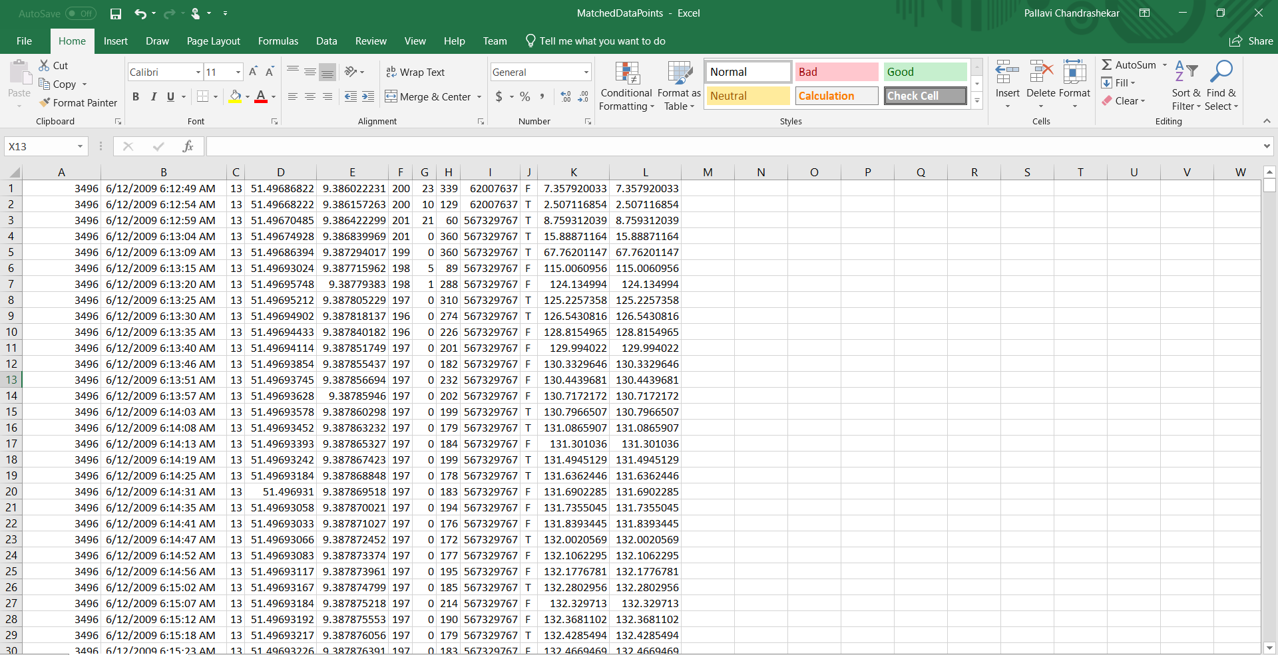
Obtained Results
All files containing output results are stored in the results folder.
MatchedDataPoints.csv:

Slide 10
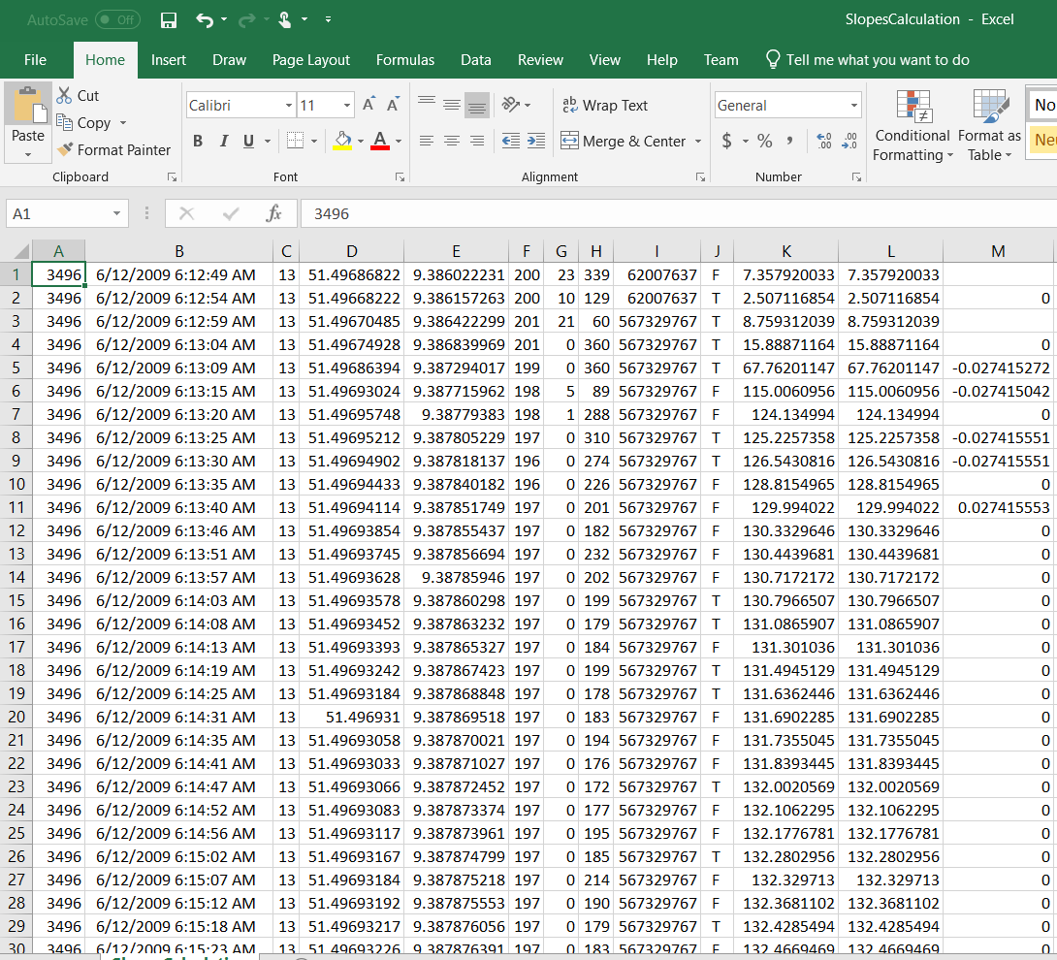
SlopesCalcuation.csv:

Slide 11
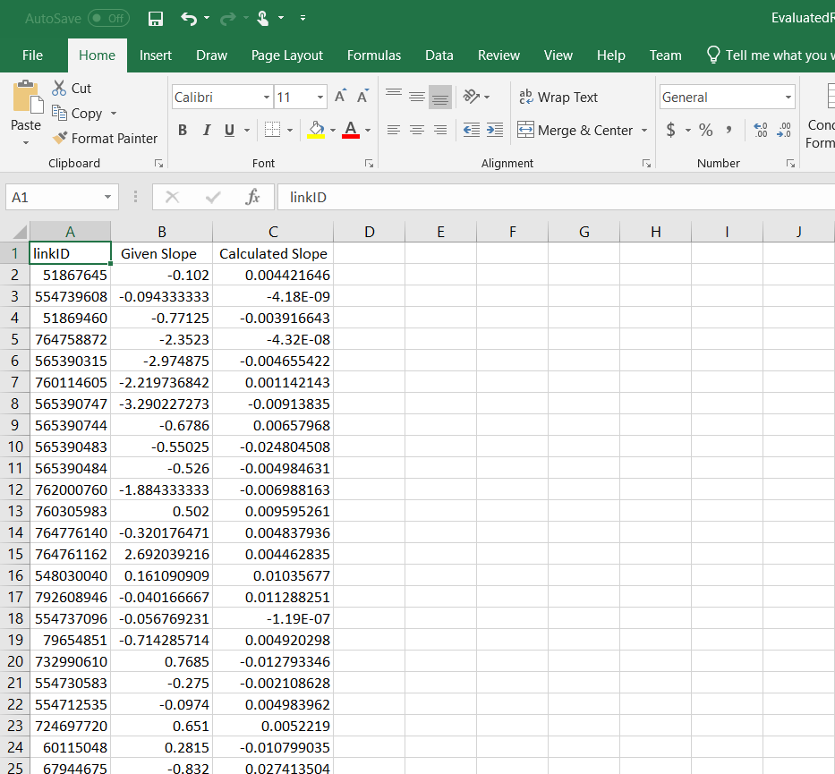
EvaluatedRoadSlope.csv:

Slide 12
References
“Online map-matching based on Hidden Markov model for real-time traffic sensing applications” by C.Y. Goh, J. Dauwels, N. Mitrovic, M. T. Asif, A. Oran, P. Jaillet (2012 ITSC).
“Map-Matching for Low-Sampling-Rate GPS Trajectories” Yu Zheng, MS Research.
Guest lecture notes by Dr. Bo Xu

